Slide 1

SIGN SENSE
-BY TEAM YODA

Slide 2

PROBLEM STATEMENT
Mute individuals encounter substantial challenges in effective communication with others, primarily stemming from difficulties in verbal expression, sensory differences, and a pervasive lack of understanding between mute and hearing individuals. To address the communication challenges, we propose developing an innovative solution leveraging natural language processing (NLP) and computer vision technologies.

Slide 3
Tech Stack
PROGRAMMING LANGUAGES:
Python (primary language for backend development and model training)
Dart (for front end development)
Google Media Pipe
Open CV
BACKEND:
TensorFlow (deep learning framework for model development)
NLTK (natural language processing library)
Pandas and NumPy (data manipulation and analysis libraries)
Firebase as BaaS
FRONTEND:
Flutter Framework (for interactive android development)

Slide 4
Stage 1: Data Collection
Gathering a dataset of accurate video recordings of individuals performing the selected gestures in the chosen sign language variant.
Constructing a secure and efficient Firebase API integration.
Real-time feedback flowing seamlessly into our system.

Slide 5

Stage 2: Training AI Models
Use image processing libraries such as : CV2, NumPy, YOLO V8 and media pipe
Hyperparameter tuning for optimal performance: Obtained % accuracy

Slide 6
Stage 3: Intuitive Frontend Development
Interactive pages
Easy login and signUp
Multiple useful pages for the users
User friendly UI/UX

Slide 7

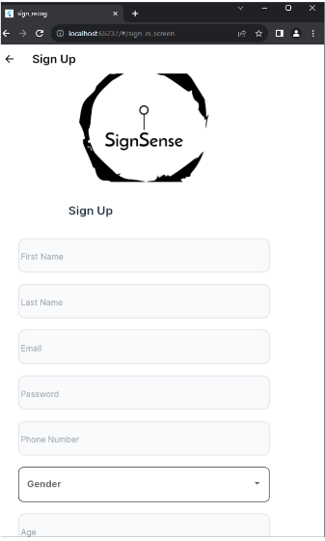
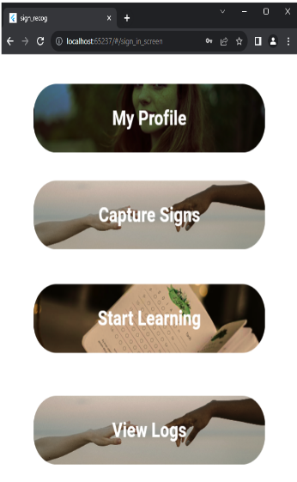
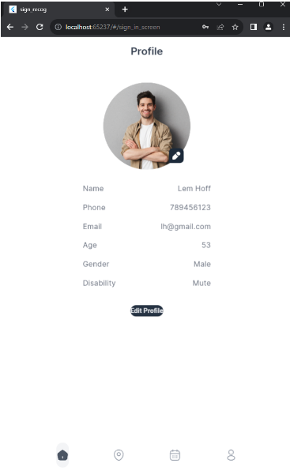

Front-end (output screenshots)

Slide 8
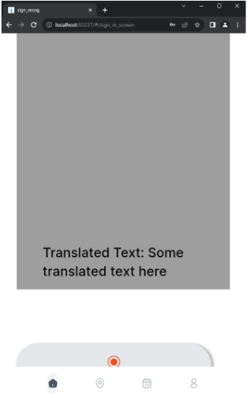
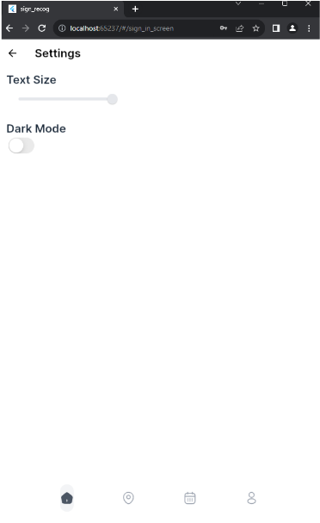
Front-end (output screenshots)

Slide 9
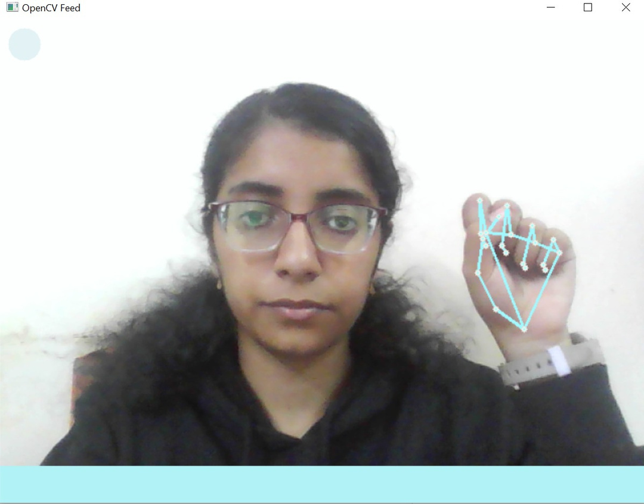
FINAL OUTPUt (screenshots)

Slide 10
Results
The app will accurately recognize and interpret a wide range of sign language gestures in real-time and will accurately translate recognized sign language gestures into text or spoken language, facilitating understanding for non-signers and enabling inclusive communication.
SignSense will feature an intuitive and easy-to-use interface, designed to accommodate both sign language users and non-signers. Clear visual cues and simple navigation will enhance usability for all users.
The app will include customizable settings such as light/dark mode and changing the text-size to enhance usability for individuals with disabilities, ensuring inclusivity and equal access to communication.

Slide 11
Team contribution
Anushka Girish- UI Designing on Figma
Avin Mantri- Front-End development
Sanika Kotgire- Back-end integration
Suhanee Hingorani- Model Development
Swara Kubade - Designing(UI)
Vedant Kumbhar- Project Workflow Design

Slide 12
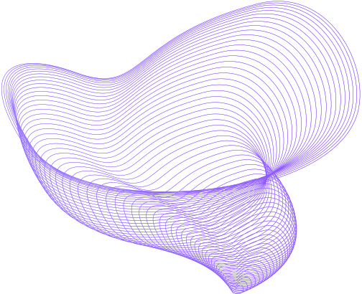
Thank You
Let’s proceed to the live demo now

